Slide 1
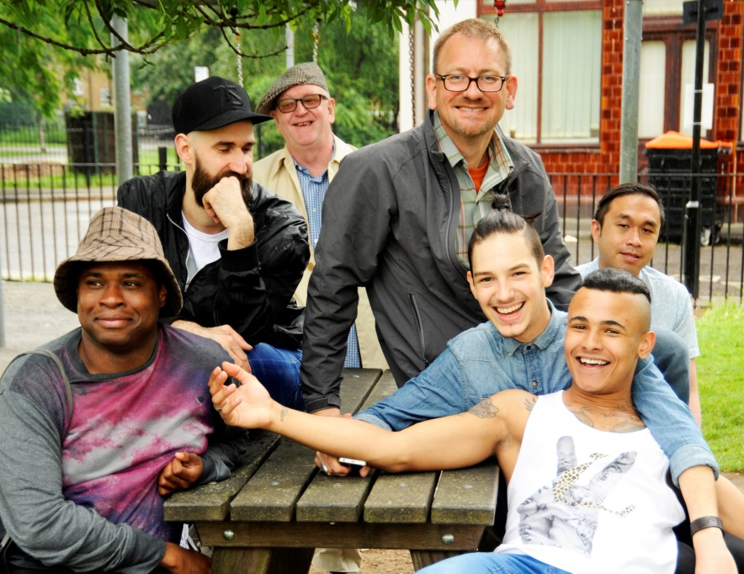
Promoting the health and wellbeing of gay, bisexual and other men who have sex with men
Dr Justin Varney
National Lead for Adults& Older People’s Health
Justin.varney@phe.gov.uk

Slide 2

Context
Gay, bisexual and other men who have sex with men (MSM) are a diverse population, including people from different faith groups, ethnicities and people with disabilities
Significant inequalities in health and other areas, such as experience or fear of stigma and discrimination despite significant improvement in social attitudes and law
Men who have sex with men remain disproportionately affected by HIV and sexually transmitted diseases and gay and bisexual men have significantly higher rates of mental ill health, poor wellbeing and higher rates of use of alcohol, cigarettes and drugs.
This is the first in a series of minority health frameworks

Slide 3
Process and Engagement to date
Evidence mapping through direct and commissioned topic overview reports on published and grey literature.
Two initial listening events in Spring 2014.
Community and academic engagement through large expert advisory group
Public consultation through .Gov consultation portal over two weeks.
Launch of briefing overview on 27th June at House of Lords reception
Further engagement planned over the next few months as action plan is developed

Slide 4
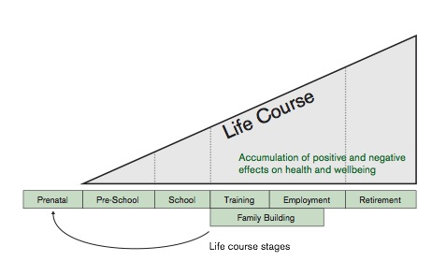
A New Opportunity: Life Course
People’s health partly reflects accumulation of risks and protective factors through different life stages.
Influenced by experiences in childhood.
Key events may vary considerably but include awareness of sexuality, development and acceptance of gay/bisexual identity, first same sex experiences and relationships, coming out to family/friends and beyond.

Slide 5
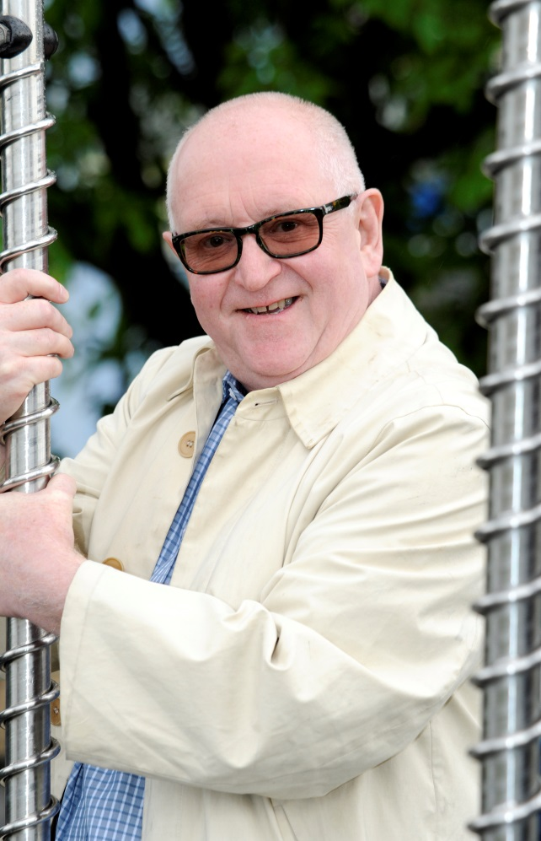
A New Opportunity: Life Course
Relative ease with which men transition through key life stages depends on men feeling accepted and supported from early age into adulthood.
The life course reminds us that expression of sexual orientation varies across the life course and that the ‘coming out’ experience happens at multiple points.
The life course approach provides a useful tool through which appropriate health promotion and prevention messages/programmes can be delivered.
Messages and programmes can be delivered in the settings and facilities with which MSM have the most contact

Slide 6
Starting Well
Earlier life stages fundamental for the development of good mental health and resilience
Development of same-sex attraction within young people carries with it the risk that acceptance and support may be withdrawn
Schools have a vital role in providing the knowledge and skills that all young people need through sex and relationships education (SRE)
85% of MSM report never having been taught about biological or physical aspects of same-sex relationships
1 in 4 STI diagnoses among young MSM are in 16-24 age group
55% of young MSM reported homophobic bullying in school
Young MSM (18-19 years) 2.4 times more likely to smoke than heterosexual men

Slide 7
Living Well
In 2012, an estimated 1 in 20 MSM were living with HIV in the UK, with up to 1 in 12 MSM in London living with HIV.
in 2012, about 78% of syphilis, 58% of gonorrhoea and 17% of chlamydia diagnoses were reported among MSM
Twice as many gay and bisexual men report moderate to severe levels of depression and/or anxiety compared with men in general. Where stigma and discrimination are apparent, this may lead to increased risk of depression and substance use. One in six lesbian, gay and bisexual people has been the victim of a homophobic hate crime or incident over the last three years
42% of gay & bisexual men drank on 3 or more days in the last week, and 67% of gay & bisexual men had ever smoked (compared to 35% and 50% respectively in the heterosexual population)
Inequalities are even greater among BME, trans & disabled gay & bisexual men

Slide 8
Ageing Well
Older MSM constitute men at very different phases of lives, ranging from employment to retirement and those requiring support at home or in care.
For those living with HIV, many will have experienced significant acute stigma and discrimination, loss and bereavement.
Major concerns include loneliness, ill health and financial issues.
Older MSM remain at risk of STIs.
In 2012, 54% of MSM aged over 50 were diagnosed late with HIV, compared to 24% under 25.
36% of older men report hiding their sexual identity throughout their lives.

Slide 9
Trio of Health Inequalities
3 distinct but overlapping areas:
      Sexual health and HIV
      Mental health and wellbeing
      Alcohol, drugs and tobacco:
These health inequalities frequently co-exist and influence each other

Slide 10
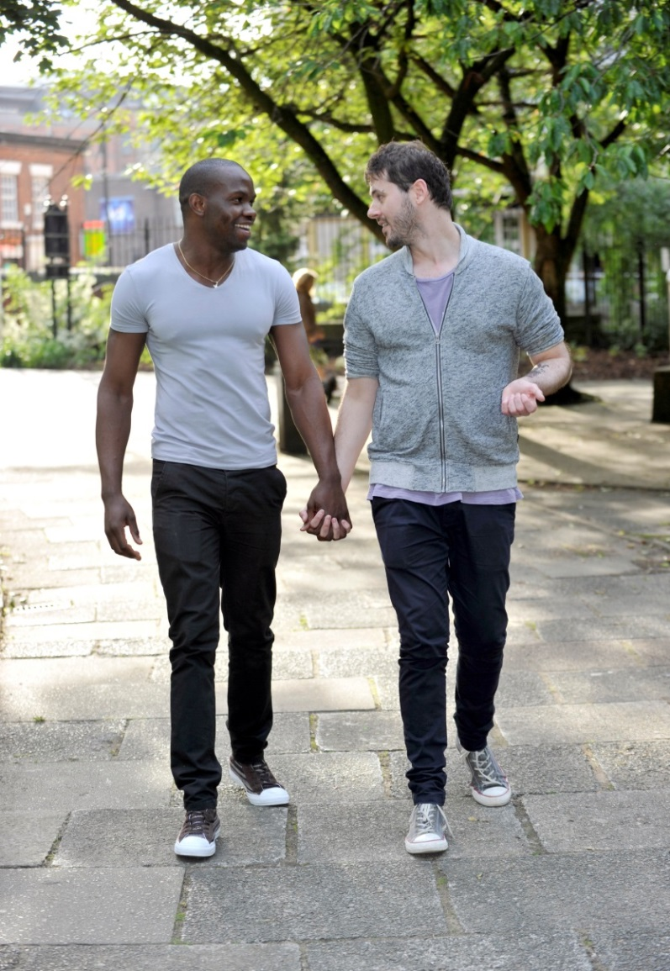
Our Vision
All gay, bisexual and other men who have sex with men (MSM) in England will enjoy long healthy lives, have respectful and fulfilling social and sexual relationships, within which the annual number of new HIV infections will be significantly reduced.

Slide 11
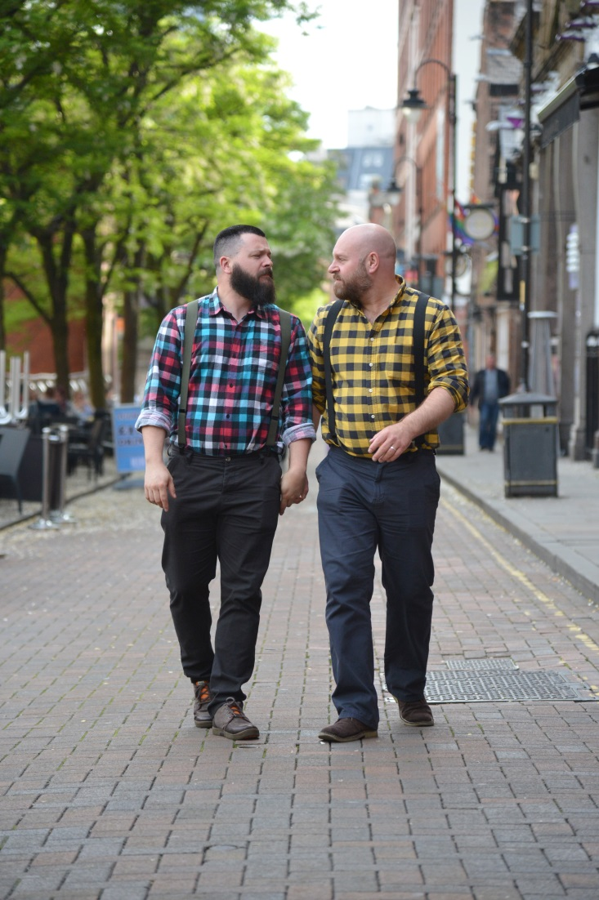
Our Vision
In achieving our vision, we want to work with men, the wider community and our partners towards:
• all MSM feeling safe and supported as they develop their sexual identity and are empowered to make healthy choices as they become sexually active
• for MSM to feel respected and valued by the community and to have the control and opportunity to make healthy choices about their lives
• for older MSM to lead longer, healthier lives, to feel supported by the community and receive appropriate health and social care support as they age

Slide 12
Evidence Base for What Works
Sexual health
      Good quality, inclusive sex and relationship education
      Regular HIV and sexual health testing
      Condom use
      Early diagnosis and treatment
      Treatment as prevention (TasP)
Mental health
      Training for supportive parenting, teachers and carers
      Interventions to reduce bullying in schools and workplaces
      Training for service providers and visibly inclusive approaches
Drugs, Alcohol & tobacco
      Culturally competent treatment pathways and services with training and imagery that is inclusive and supports engagement

Slide 13
National LGBT Strategic Partnership
The National LGB&T Partnership is an England-wide group of LGB&T voluntary and community organisations who are committed to reducing the health inequalities of lesbian, gay, bisexual and trans communities and to challenging homophobia, biphobia and transphobia within public services.
The Partnership is supported by the Department of Health, Public Health England and NHS England. Projects this year are:
Sexual Orientation Monitoring, Paul Martin, The LGF paul.martin@lgf.org.uk
Case Studies- Paul Roberts, Consortium paul.roberts@lgbtconsortium.org.uk
Trans Guide to Healthy Living- Bernard Reed, GIRES bernardgi@aol.com
PHOF LGBT Companion Tools- Patricia Durr, patricia@metrocentreonline.org
Physical Activity- Steph Keeble, Birmingham LGBT stephkeeble@blgbt.org
Tobacco- Matthew Hodson, GMFA matthew.hodson@gmfa.org.uk
Alcohol- Monty Moncrieff, London Friend monty@londonfriend.org.uk
Adult Social Care Outcomes Framework Companion- Paul Roberts, Consortium
http://nationallgbtpartnership.org

Slide 14
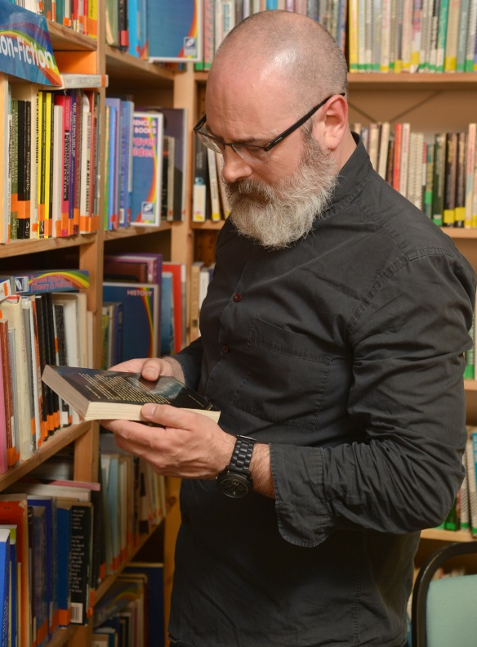
PHE Actions: Data & Surveillance
support alcohol, drug and tobacco and mental health services to collect data about sexuality
enhance data and intelligence on prevalence of alcohol and drug use (including “chemsex”) across the lifecourse
monitor both HIV incidence and prevalence in MSM and rates of STIs and identify and manage outbreaks
monitor the clinical outcomes and quality of life of MSM living with HIV
provide data through its national mental health intelligence network on the mental health of young LBGT
support the inclusion of sexual identity data to be collected in the audit and evaluation of services for older people.

Slide 15

PHE Actions: Evidence
provide evidence to inform appropriate use of HPV vaccines among MSM
publish guidance to support local areas aiming to achieve large scale changes in health outcomes for adults and older MSM
make recommendations on anal cancer screening in HIV positive men based on findings of the ANALOGY study
publish and promote briefings to support local authorities to meet the needs of MSM involved in “chemsex”
develop and disseminate the evidence base and learning from community development programmes aimed at reducing HIV and STI risk

Slide 16
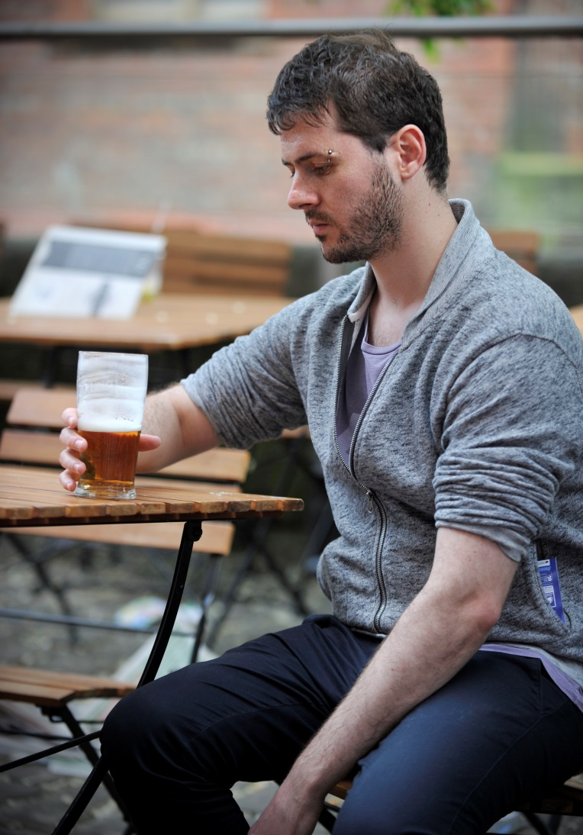
PHE Actions:
develop the FRANK and Rise Above drug education and prevention campaigns and ensure they are relevant to the needs of young MSM.
ensure social marketing programmes and information campaigns are relevant and appropriate for MSM across the life course.
use its leadership role to champion community approaches which are inclusive and respond to the needs of diverse groups of MSM across the life course.
be an exemplar in promoting and supporting an inclusive and diverse workplace, taking part in the Stonewall Equality Index to benchmark ourselves.

Slide 17
PHE Project: BME MSM
Supported by a grant from the MAC Foundation PHE will be leading a project focused on black and minority gay, bisexual and other men who have sex with men.
The project includes:
      Supported learning set through the BME, LGBT and Faith national strategic partnership
      E-learning modules on sexual orientation and ethnicity for health care professionals
      Pilot and evaluation of three models of intervention for health and wellbeing with BME MSM
      Evaluation and expansions of the NAZ online platform for engaging with BME MSM

Slide 18
Actions for all
Core themes:
Improved data collection and analysis
Increased training across professional groups
Specific consideration of gay, bisexual and other MSM needs
Scale up existing evidence based implementations such as regular sexual health and HIV testing
Engagement with the community and strengthening community recognition and engagement with the issues
Visible role models and champions
Levers to support implementation
Legislative levers – Equality Act & Inequality Duties
National LGBT Strategic Partnership with DH & NHS England
New LGBT academic network

Slide 19
Next Steps
PHE’s PRIDE celebration event launched the publication of summary document: at the House of Lords: https://www.gov.uk/government/uploads/system/uploads/attachment_data/file/324802/MSM_document.pdf
Summary document will be the first in a trio of PHE documents, which will collectively set out our vision, our evidence base and recommendations for action with a range of partners
At the end of July we will publish our ‘initial findings’ document, setting out the scope of the challenge, our strategic direction and the evidence we have gathered through the literature review and stakeholder engagement
We will work to co-produce a national Framework and Implementation plan : by end of year

Slide 20
Working Together
Communities
Local government
Voluntary Groups
NHS, Police, Schools, Universities, Workplaces
National Organisations
For the framework and implementation plan we look forward to continue working with a wide range of stakeholders over the next few months to:
•co-produce priorities
•set clear objectives
•agree areas of responsibility
•determine relevant actions

Slide 21
Further information:
Dr Elaine Rashbrook (MSM Framework Project Lead)
Divisional Consultant, Health & Wellbeing Directorate
Elaine.rashbrook@phe.gov.uk
Dr Justin Varney (BME MSM Project Lead/ LGBT Topic Lead)
National Lead for Adults and Older People’s Health and Wellbeing
Justin.varney@phe.gov.uk

