Slide 1


London Low Emission Construction Partnership
Cleaner Air For All Londoners
19th July 2016
Daniel Marsh

Slide 2









Notes:
Mayors air quality fund project in round 1 and 2
Partnership project with GLA, TfL, central London boroughs, developers, contractors, plant manufacturers and low emission technology providers….
Member boroughs doubled in round 2 highlighting success or r1, increased need for support in NRMM policy enforcement

Slide 3
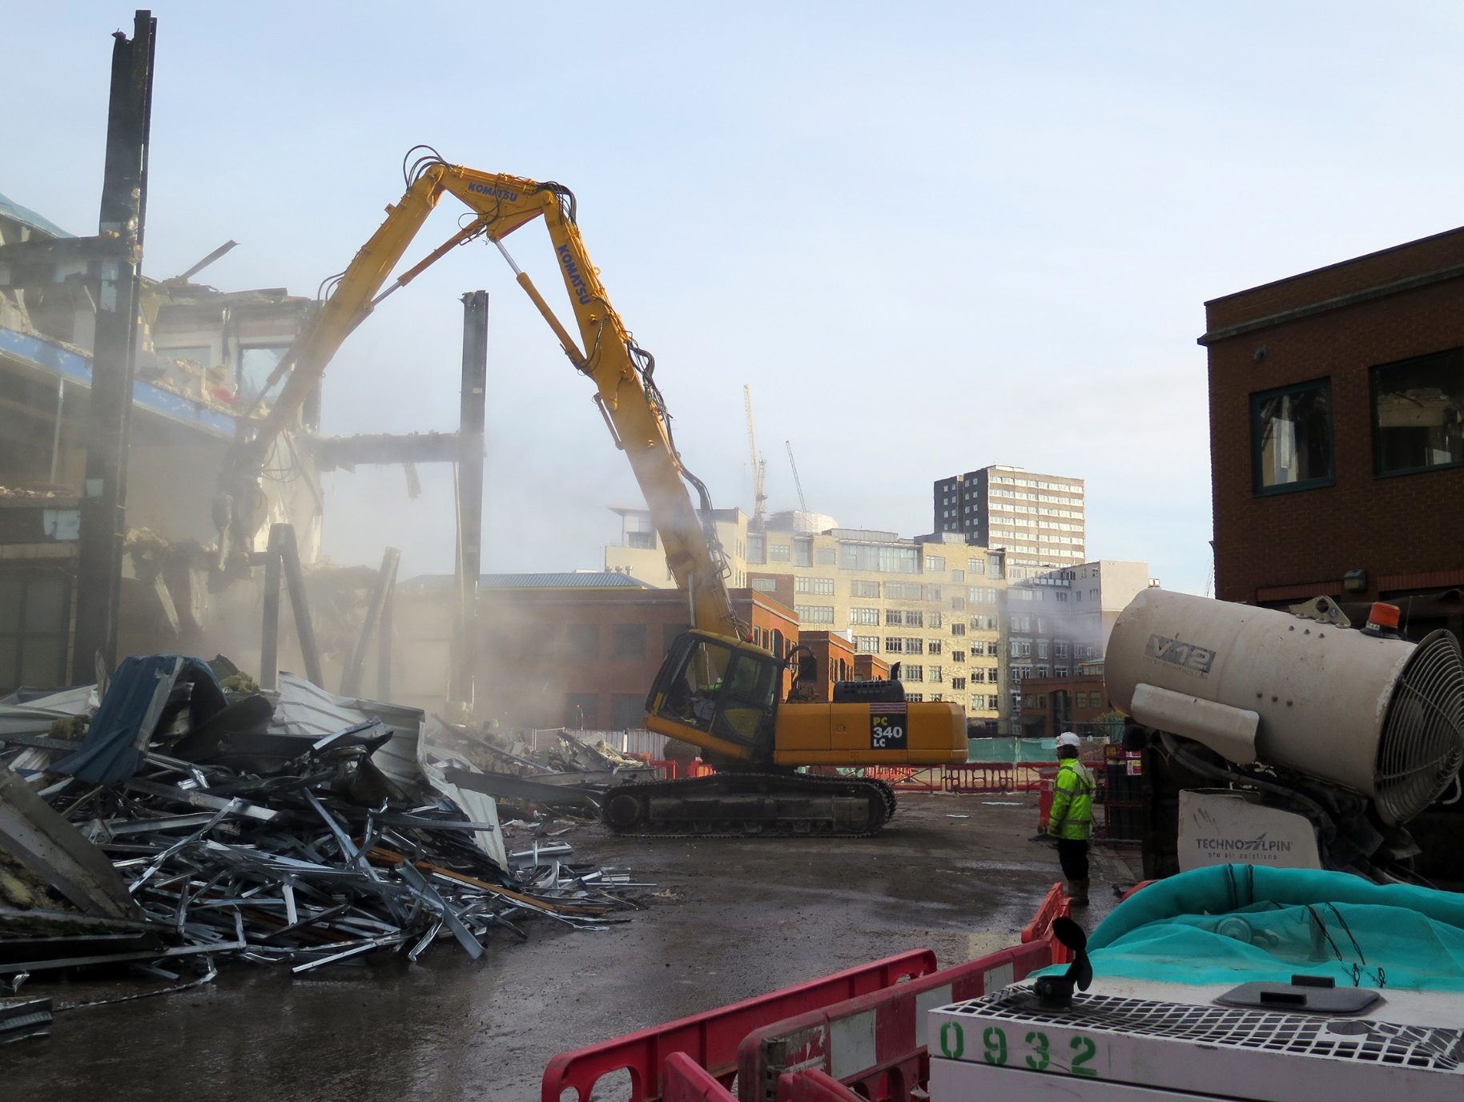
Construction Emissions
Notes:
Talk about exhaust and non-exhaust emissions – mechanical breakdown, earthworks and NRMM – hard to quantify sources

Slide 4
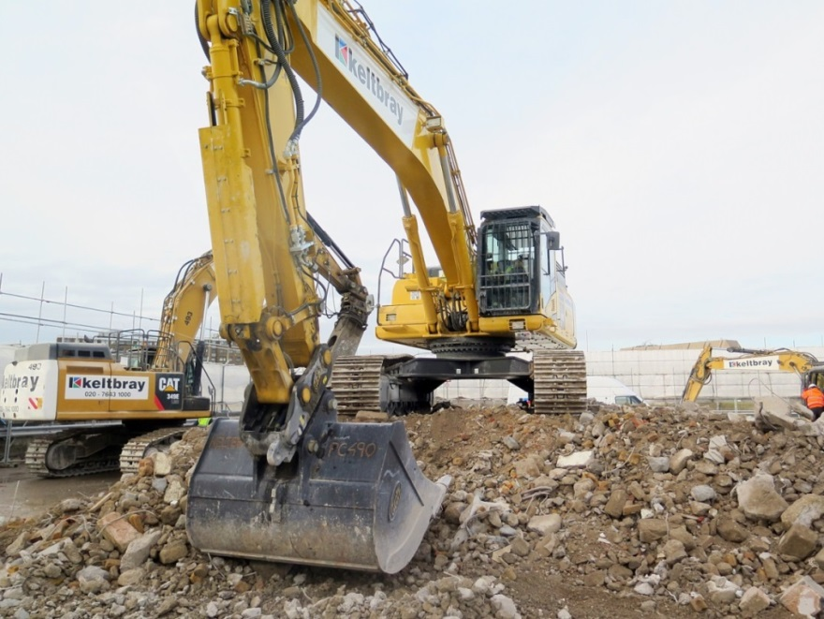
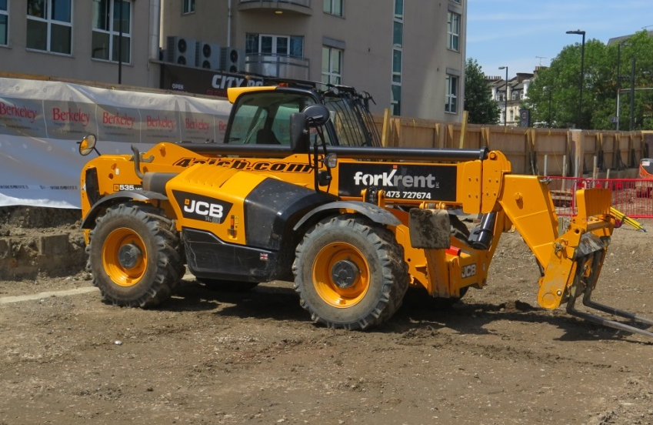
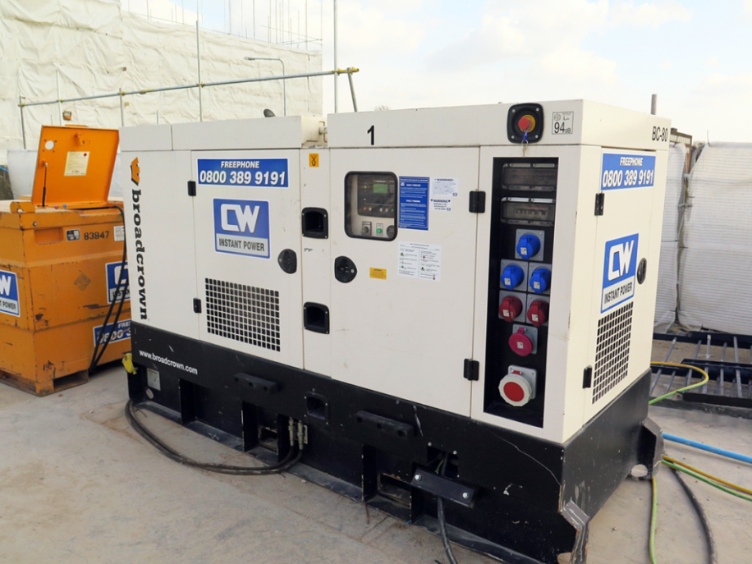
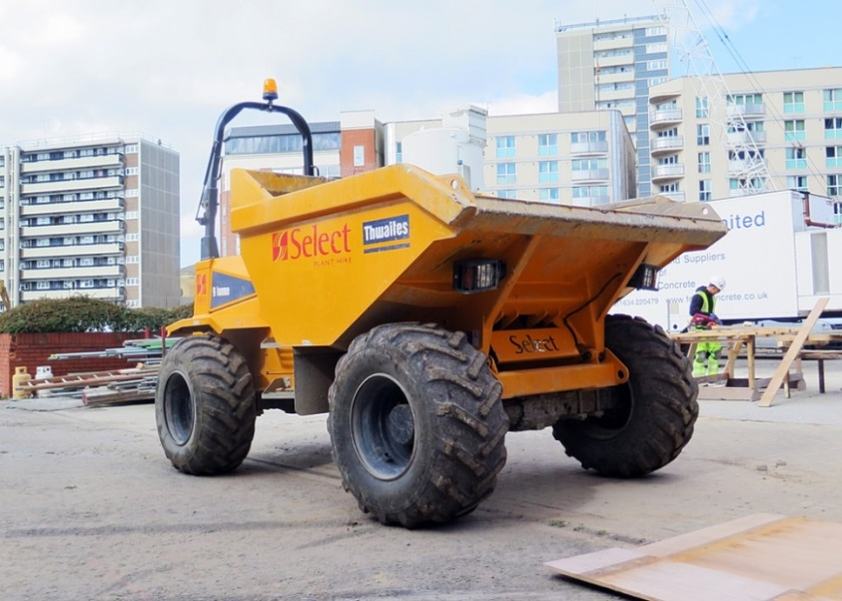
What is non-road mobile machinery?
Notes:
NRMM is defined as any mobile machine, item of transportable industrial equipment, or vehicle - with or without bodywork - that is not intended for carrying passengers or goods on the road
installed with a combustion engine – give examples
Industry very diesel dependant, engines lag behind on-road standards

Slide 5
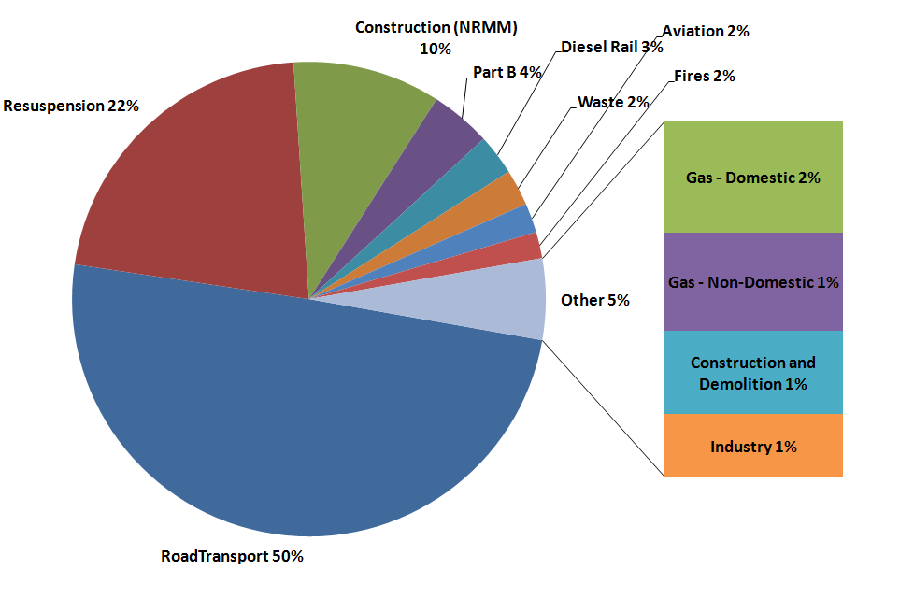
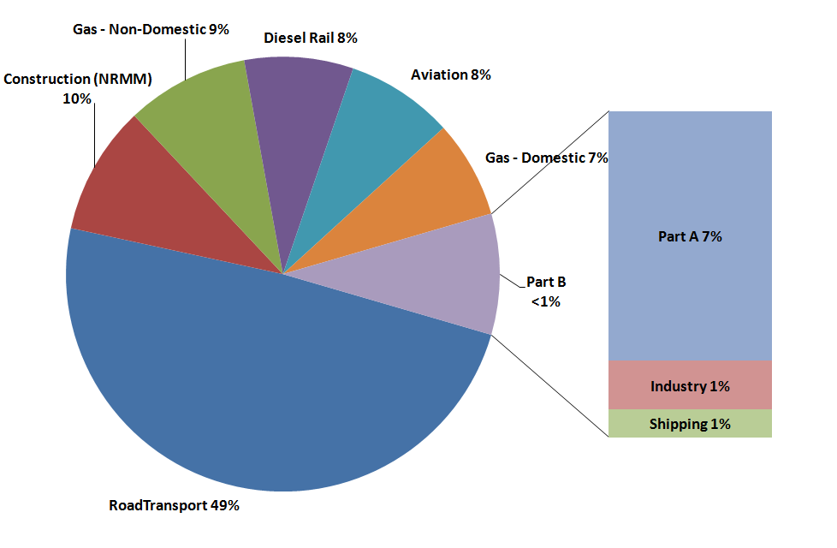
How important are construction emissions in London?
1% of PM₁₀
from construction
and demolition
10% of NO_{X}
from NRMM
10% of PM₁₀
from NRMM
London Atmospheric Emissions Inventory 2010
Notes:
Why target construction industry?
Road emissions are being reduced though LEZ/ULEZ so other sectors increase in importance
LAIE 2010 – similar output in 2013 results….
Increase in local concentrations, fugitive or nuisance dust emissions and diesel driven industry – recognised health impacts

Slide 6

Industry Outreach
Raising awareness of industry impacts on local air quality
Testing
Measure ‘real world’ emissions
NRMM
LEZ enforcement
Improve pollution monitoring and quality of data
Encourage uptake of ‘cleaner’ mitigation measures
Policy support
NRMM database
Emission reduction trials
Present case studies with cost benefit for low emission solutions
Notes:
Industry outreach – presentations, social media, website etc – success – awards, blogs, videos
Testing – mention dust mitigation and NRMM reduction technology – fuel additives, retrofit and reduction such as hybrid generators
NRMM – support of GLA LEZ policy, enforcement – developing tools and training packages, NRMM register – world first!

Slide 7
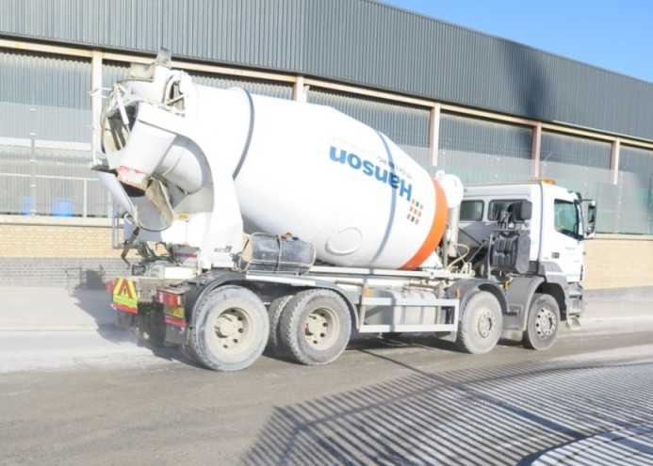

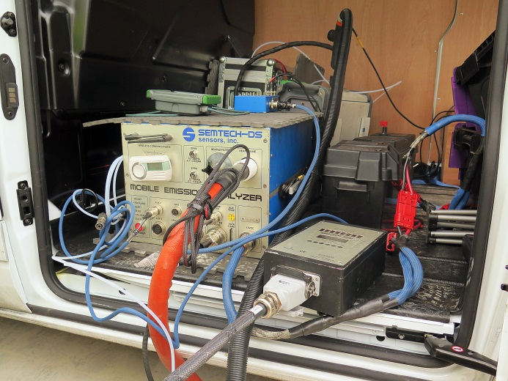

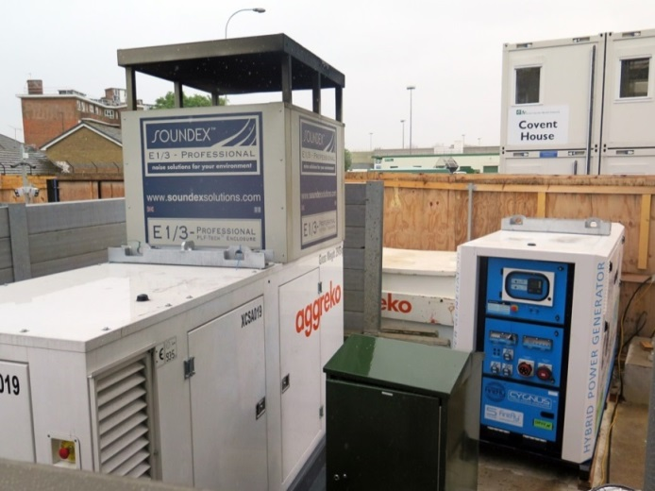
Emission reduction trials
Dust suppressant
PEMS
Fuel additive
Green eco-mode /
fuel additive
Hybrid power
Notes:
PEMS equipment – Emissions Anayltics – same a real world driving emission testing that discovered mismatch in on-road vehicles

Slide 8
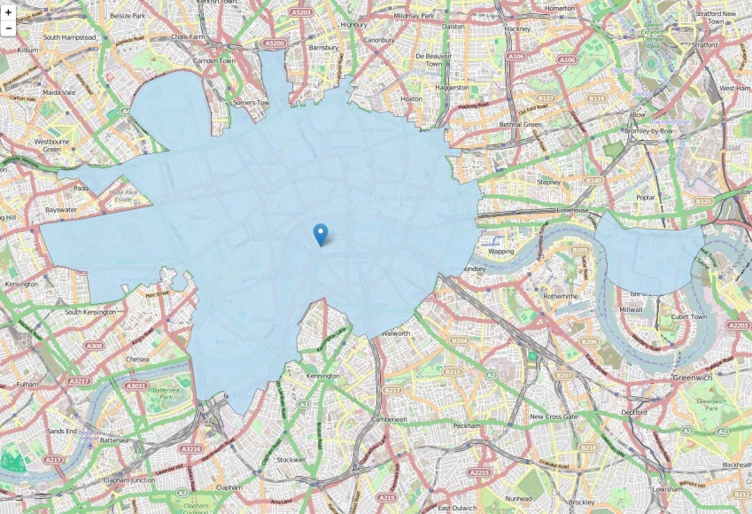
Cleaner machinery for London
London is the first city in the world to introduce a Low Emission Zone for NRMM
Sets cleaner standards for machines used on construction sites
Register for all construction equipment
Allows for enforcement through the local planning authority
MAQF funded officers
for NRMM enforcement
Notes:
First in the world
2 tier zones for EU emission stages, started in September 2015 then goes to next stage in 2020 in line with the ULEZ
SPG – Control of dust and emissions during construction and demolition – allows for enforcement
GLA funding new NRMM officers hopefully with new powers

Slide 9
Conclusions
The construction industry is a significant source of PM and NO_{X} pollution in London
Working in partnership with construction industry to raise awareness of air quality impacts
Industry is very receptive to new ideas and technology to reduce emissions
Creating an ‘evidence base’ for low emission technology to identify best techniques

Slide 10
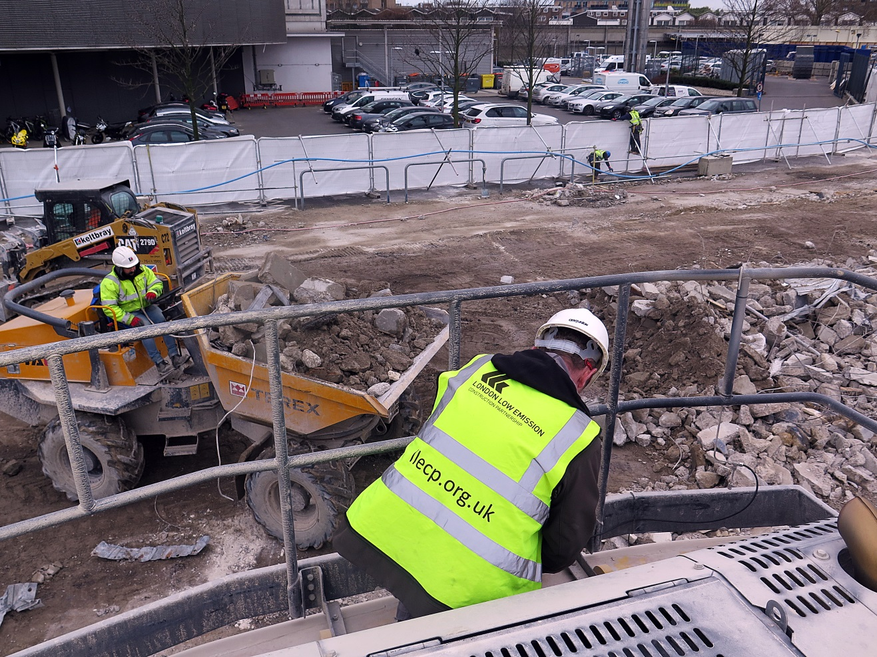

llecp.org.uk
nrmm.london
@ConstructionDustUK

