Slide 1
London Schools’ Climate Kick-Start
Lesson Resource

Slide 2
Part 1
What is COP and why does it matter?
(20 minutes)

Slide 3
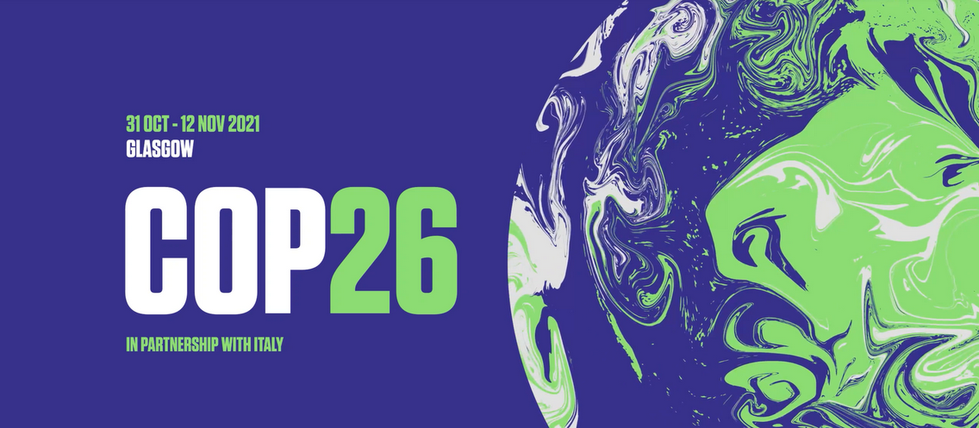
From 1-12 November 2021, COP26 will take place in Glasgow.
197 countries have signed up to the United Nations Framework Convention on Climate Change (UNFCCC).
A ‘Conference of the Parties’ or ‘COP’ is when these countries meet to discuss climate change.
Each country sends a team of decision makers to represent them.
As this is the 26th meeting, we call it COP26. It’s the first time the meeting is being held in the UK!
What is COP and why does it matter?
Notes:
Image - WWF UK
https://www.wwf.org.uk/

Slide 4
They will discuss:
What is the latest science on climate change? What do we know about how our climate is changing?
How is action to address climate change going? Is every country doing enough?
What more do we need to do to limit future climate change?
What is COP and why does it matter?
Notes:
Image - WWF UK
https://www.wwf.org.uk/

Slide 5
Discuss:
Why do you think conferences like this are important?

Slide 6
What is the key message of this video?
URL link - https://youtu.be/CjtcNGGkKIA
With thanks to WWF UK and Kae Tempest
What is the key message of this video?
Notes:
URL link - https://youtu.be/CjtcNGGkKIA

Slide 7
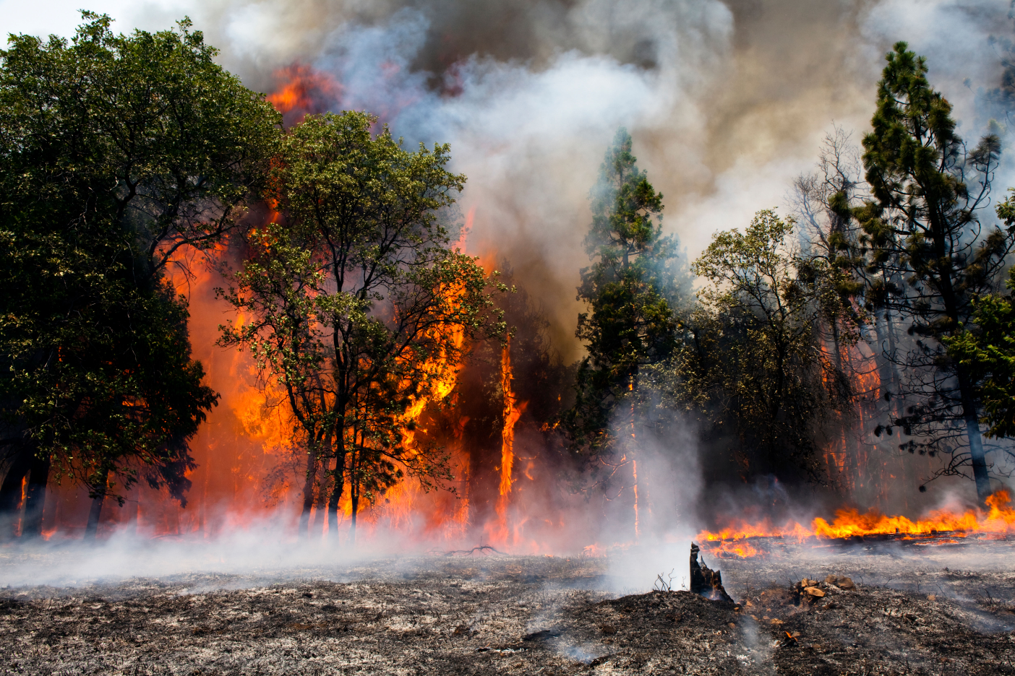
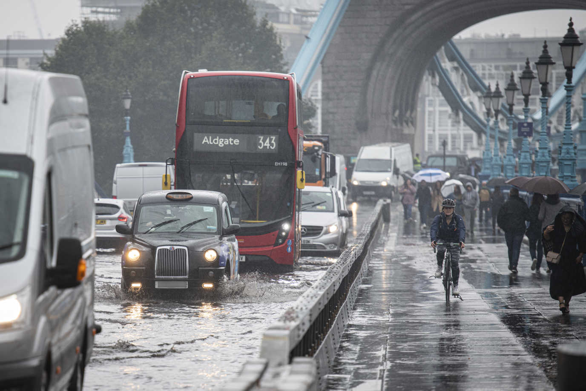
“We are the first generation to feel the effect of climate change and the last generation who can do something about it."
Barack Obama
Extreme weather events such as wildfires, flooding and heatwaves, are becoming more common and people are talking about climate change with more urgency.
There is a sense of now or never with climate action and COP26.
What is COP and why does it matter?
Image Credit: Alamy
© Greater London Authority
Notes:
Wildfire: Alamy stock image

Slide 8
The science is clear.
If we don’t take action now, it will be impossible to avoid the worst impacts of climate change.
Discuss:
What is happening globally to help reduce our impact on our planet?
What else could we do to reduce our impact on the planet?
What would you like to see happen as a result of COP26?
What is COP and why does it matter?

Slide 9
Discuss:
What is happening globally to help reduce our
impact on our planet?

Slide 10
Discuss:
What else could we do to reduce our impact
on the planet?

Slide 11
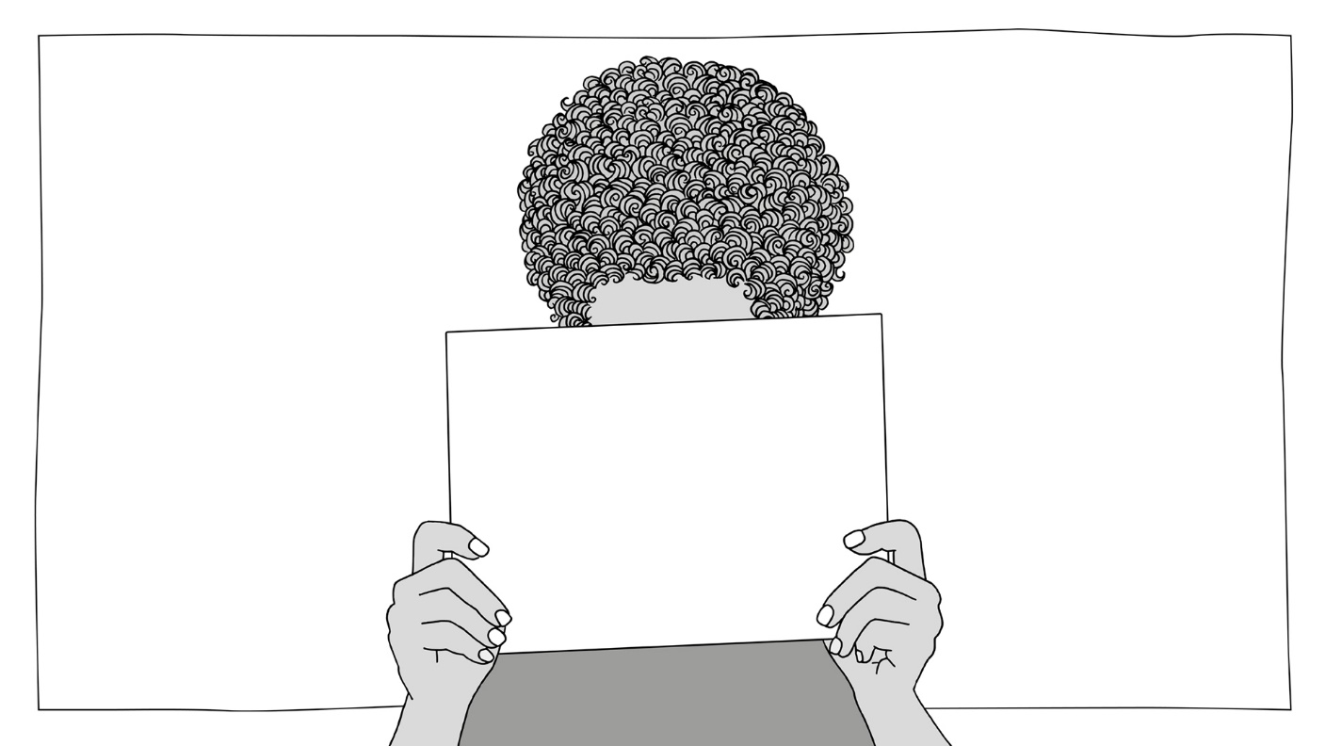
Discuss:
What would you
like to see happen
as a result of
COP26?

Slide 12
London Schools’ Climate Kick-Start
Lesson Resource

Slide 13
Part 2
Climate Change and London
(20 minutes)

Slide 14
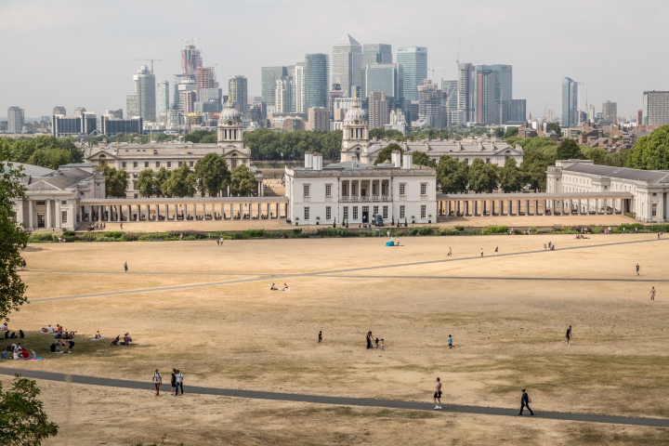
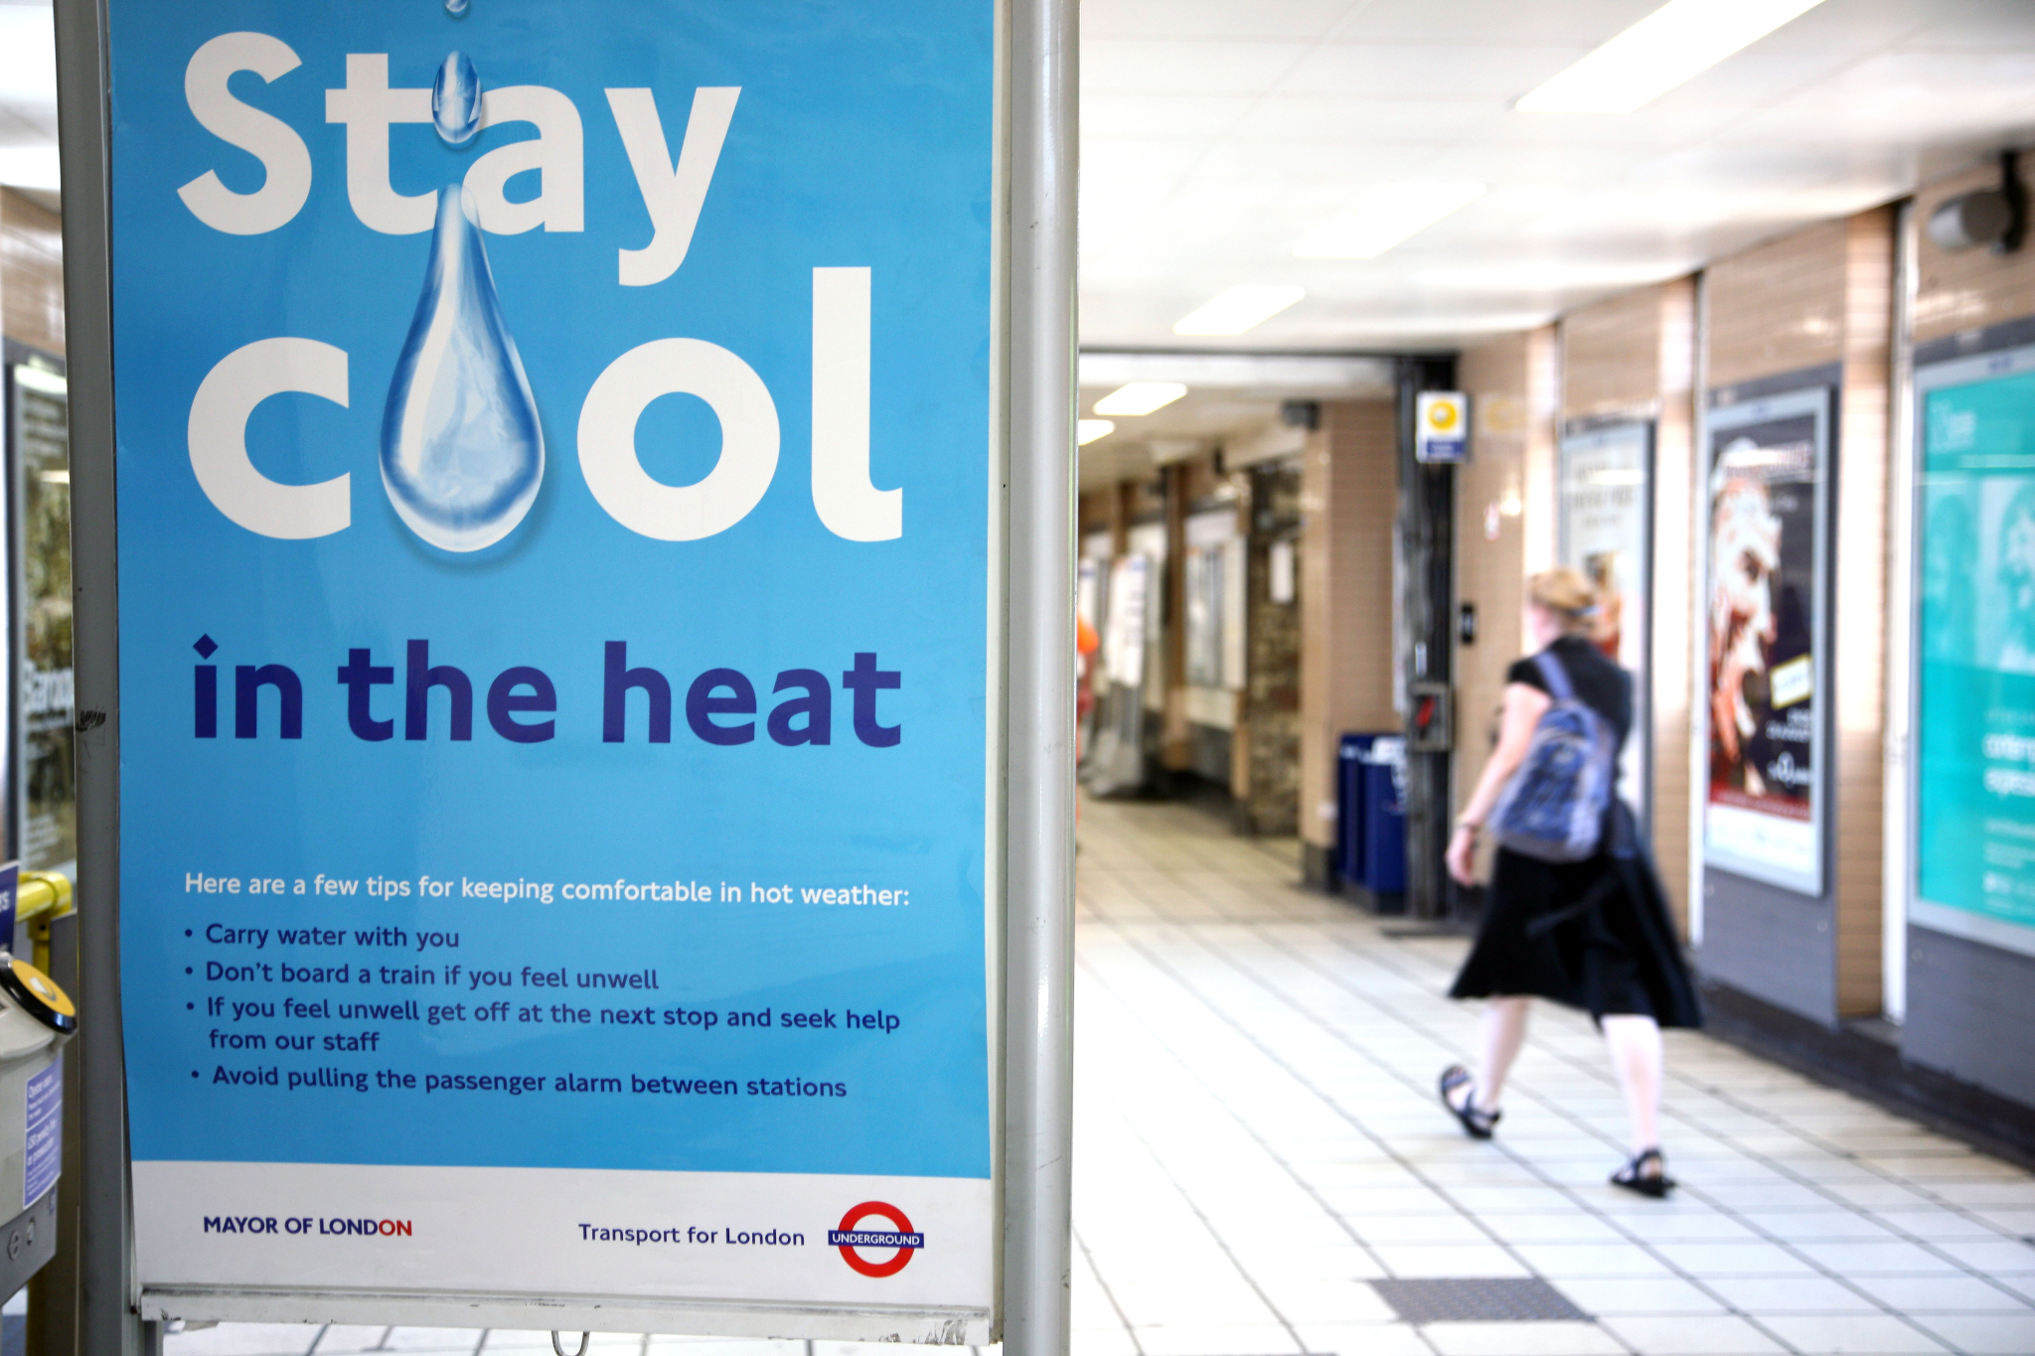
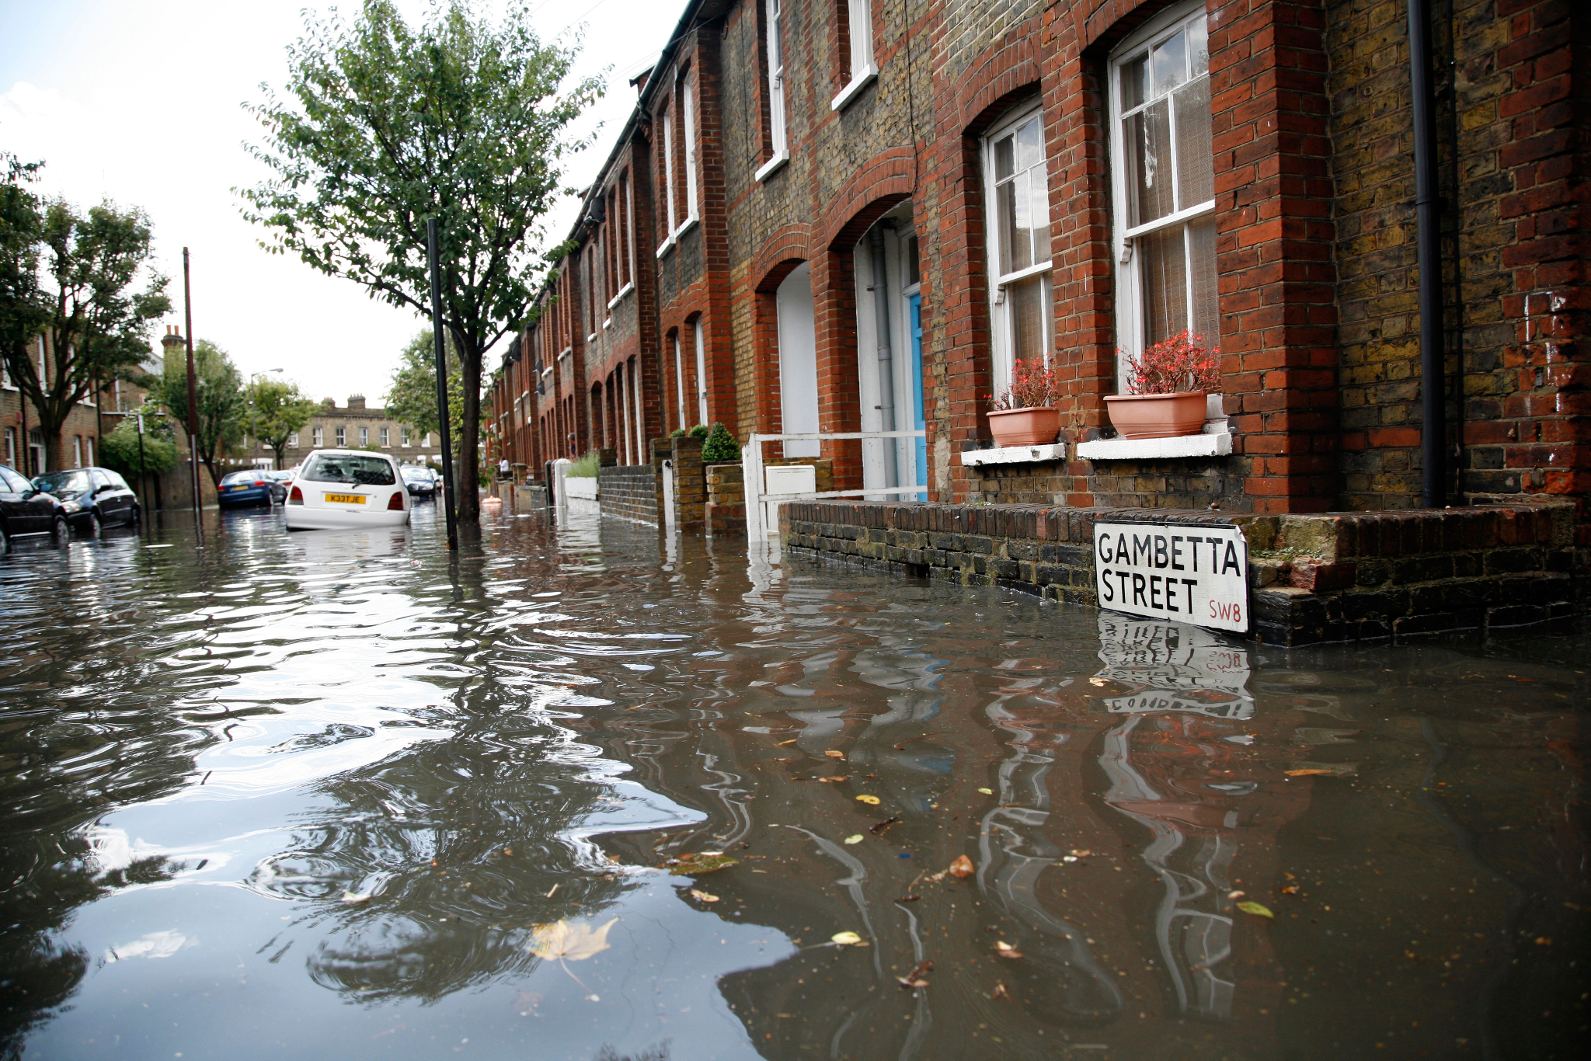
In this part, we’ll explore climate change locally in London.
Look at the images.
They illustrate ways Londoners are already being affected by climate change.
What does each image show and how does it link to climate change?
Image Credits: Alamy
Notes:
Images: Alamy stock

Slide 15
Discuss:
What does each image show and how does it link to climate change?

Slide 16
This image shows a Transport for London sign that’s used during hot weather.
As global temperatures rise, average temperatures in London will also increase.
Living in a city like London can feel much hotter than the countryside, as the buildings and roads store up more of the sun’s heat.
A 2019 report said that if London’s average temperature rises by 1.5°C, two thirds of the city’s flats could experience overheating by 2030 (temperature over 28°C).
Image Credit: Alamy
Why should Londoners care about climate change?
Notes:
Image: Alamy stock

Slide 17
This image shows just how dry Greenwich
(in South East London) became in the summer of 2018.
London is predicted to become drier in the summer as temperatures increase due to climate change.
Not only does this dry out the ground but it could cause problems for the availability of drinking water.
We use more water in hot, dry weather to keep people and plants cool and hydrated.
Image Credit: Alamy
Why should Londoners care about climate change?
Notes:
Image: Alamy stock

Slide 18
This image shows a flooded street in South London.
The risk of flooding is increasing in London.
Summers in London are predicted to become drier but winters will become wetter.
When it does rain in summer, it is likely to be unpredictable heavy downpours which lead to flooding.
Image Credit: Alamy
Why should Londoners care about climate change?
Notes:
Image: Alamy stock

Slide 19
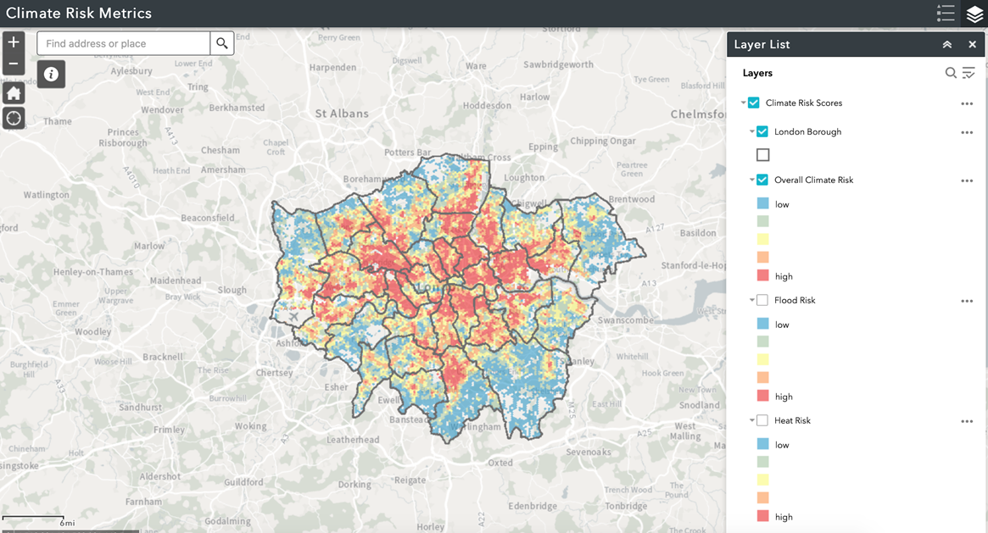
Follow this link to look at the latest climate risk for your area.
Find the area where your school is.
What is the overall climate risk of this area?
Which is a higher risk for this area: flooding or heat?
Compare this to other areas of London that you know - how does it compare?
Why should Londoners care about climate change?
Notes:
Link to GIS Climate Risk:
https://gisportal.london.gov.uk/portal/apps/webappviewer/index.html?id=7322196111894840b5e9bae464478167

Slide 20
Why is London important in action against climate change?
Video link: https://youtu.be/wM4bSAIxy6U
With thanks to the Museum of London
Why is London important in action against climate change?
Notes:
Video link: https://www.youtube.com/watch?v=wM4bSAIxy6U

Slide 21
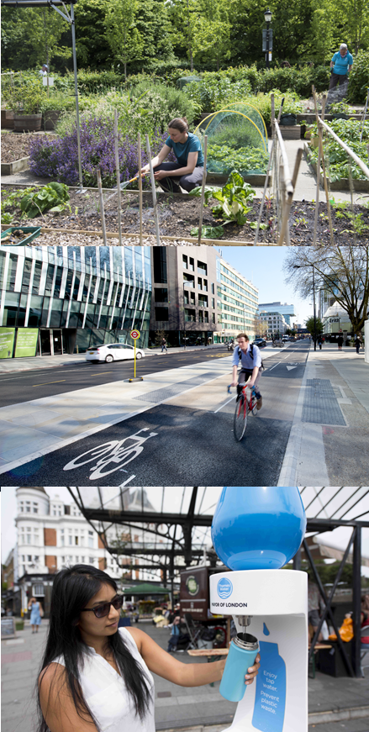
Now you’ve seen a few examples of climate action in London…
Discuss:
What are you doing to reduce your impact on the planet?
What else could you do to reduce your impact on the planet?
What would you like to see happen as a result of COP26?
Why is London important in action against climate change?
© Greater London Authority

Slide 22
Discuss:
What are you doing to reduce your impact on the planet?

Slide 23
Discuss:
What else could you do to reduce your impact on the planet?

Slide 24
Discuss:
What would you like to see happen as a result of COP26?

Slide 25
London Schools’ Climate Kick-Start
Lesson Resource

Slide 26
Part 3
Why does climate change need a global effort?
(20 minutes)

Slide 27
At COP26 in Glasgow this November, the 197 members of the UNFCCC will meet to discuss climate change.
We need a global approach to climate change, as it will affect the entire planet.
We all need to work together to help reduce the impacts.
Why does climate change need a global effort?
Notes:
Image - WWF UK
https://www.wwf.org.uk/

Slide 28
Why does climate change need a global effort?
Video link https://youtu.be/faQvTuXq2dQ
With thanks to BBC Teach
Why does climate change need a global effort?
Notes:
BBC Teach link -https://www.bbc.co.uk/teach
Video link https://youtu.be/faQvTuXq2dQ

Slide 29
Discuss:
What has happened to the island
of Kale and how
does it link
to climate change?

Slide 30
Discuss:
Why is Gladys worried about
the future? What upsets her about climate change?

Slide 31
“The Solomon Islands produce less than one hundredth of 1% of global greenhouse gases. But along with other low-lying Pacific islands, they are paying the highest price as rising sea levels put them on the frontline of climate change.”
Ade Adepitan
Climate justice is about recognising that climate change affects disadvantaged groups of people the most, such as those living in developing or low-income countries.
We have to ensure that our actions against climate change protect the most vulnerable groups and address global inequalities.
How is Ade’s quote linked to the idea of climate justice?

Slide 32
Discuss:
How is Ade’s quote linked to the idea of climate justice?

Slide 33
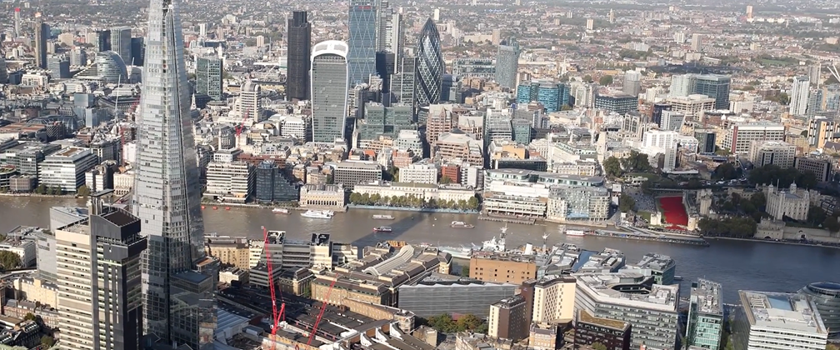
In London, as with many other cities around the world, the most vulnerable groups of people will be most impacted by climate change.
Can you think of any reasons why this might be? Think back to the climate risk map.
Where are the richest areas?
Where are the poorest areas?
Where is the air quality better / worse?
Where are flood risks higher?
Where are London’s green spaces?
Where are the traffic heavy areas?
Where is the housing most likely to overheat?
What does climate justice mean for London?
Notes:
Image: Still from Climate Change and London
Video link: https://youtu.be/qvlpmnhhdhs

Slide 34
What does climate justice mean for London?
In London, the most expensive housing tends to be near the largest and most accessible green space.
It tends to be away from the airports and busiest roads, meaning that air quality is better and the risk of flooding is lower.
In contrast, poorer parts of the city have less access to green space, worse air quality and thus are more at risk from the impacts of climate change.
Lower quality, more densely packed housing tends to be more prone to overheating in summer.
We need to ensure that our actions against climate change take these inequalities into account and protect the most vulnerable groups.
What does climate justice mean for London?

Slide 35
London Schools’ Climate Kick-Start
Lesson Resource

